Slide 1
What is a Brand?

Slide 2
Overview
Origin of branding
Definitions of brand
Benefits of branding
Who controls the “meaning” of a brand?
Brand strategy and brand engineering

Slide 3
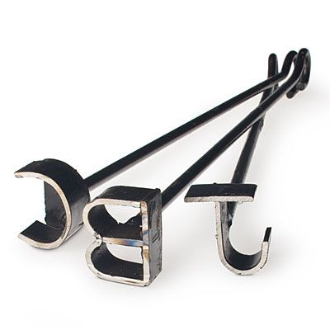
Branding Origins
“Branding” has been around for centuries.
Origin of the term in the Old Norse word, brandr, which means “to burn.”

Slide 4
Official Definition of “Brand”
“...a name, term, sign, symbol, design, or combination…intended to IDENTIFY the goods or services of one seller…and to differentiate them from the competition.”

Slide 5
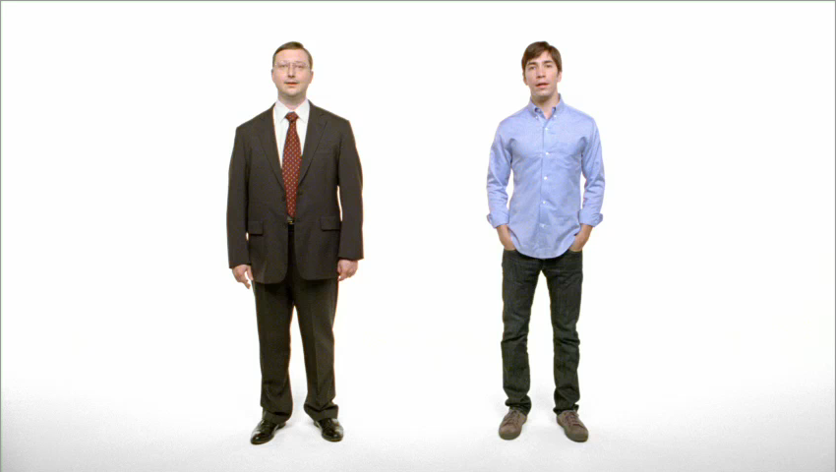
User-Friendly Definition
A brand is a source of a promise of relevantly differentiated benefits.

Slide 6
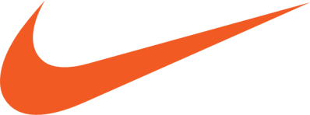


What is a Brand – Really?
A distinguishing name, mark, or symbol
A signature indicating source or origin
A signal of quality
A badge of customer identification
A “virtual contract” between consumer/brand

Slide 7
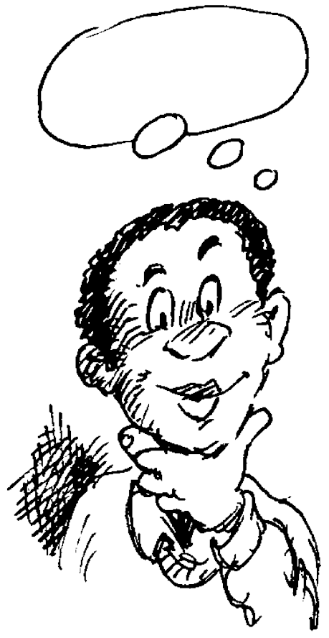

A Legendary Ad-Man’s Take on the Subject
“ A brand is the consumer’s IDEA of a product.”
– David Ogilvy

Slide 8


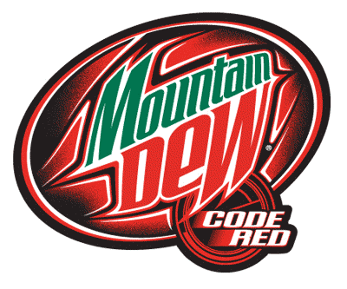
Branding Benefits to the Consumer
Comfort, familiarity, confidence in decisions
Aid (simplification) in decision making
Add intangible value
Transform the experience

Slide 9
Branding Benefits to the Manufacturer
Source of competitive advantage
Asset with tangible and lasting market value
Employee attraction/retention

Slide 10
Authors of Brand Culture
Popular Culture
The Firm
Brand
Stories
Brand Culture
(Shared, taken-for-granted brand stories, images, and associations)
Brand
Stories
Brand
Stories
Brand
Stories
Influencers
Customers

Slide 11
Designing Brand Strategy
Brand Strategy
Strategy Drivers
Environment
Changes
Competitive
Benchmarking
Brand Culture Goal
- Product Reputation
- Relationship Perceptions
- Experience Framing
- Symbolism
Existing Brand Culture
- Product Reputation
- Relationship Perceptions
- Experience Framing
- Symbolism
Brand Engineering
Product Design
Service Delivery
Service Quality
Packaging
Advertising
Personal Selling
Public Relations
Corporate Comm.
Corporate Actions
Channel Policy
Retail Design
Customer Interface
Pricing
Promotions

Slide 12
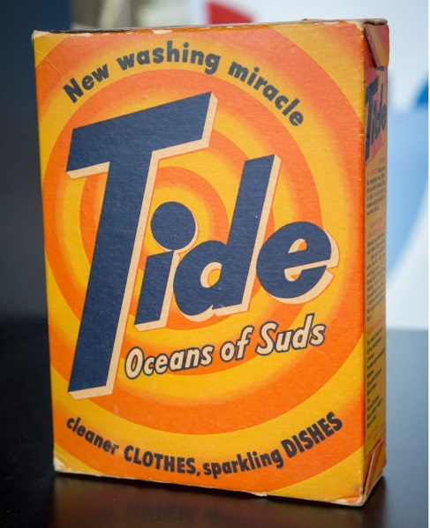
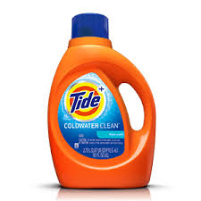
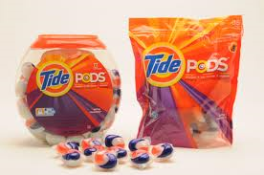
Implications
To remain relevant, a brand must adapt over time
“A strong brand is a reward, not a goal.”
– John Deighton, Harvard Business School

Slide 13
Conclusion
What are some of your personal favorite brands?
What makes them strong brands?
How do your organization’s customers view your brand(s)?

Slide 14
End of Lecture

